Slide 1
جبر بول
Boolean Algebra

Slide 2
جبر بول
عامل اصلي قوت سيستم‌هاي ديجيتال:
  جامعيت و قدرت فرمولاسيون رياضي جبر بول
مثال:
IF the garage door is open
AND the car is running
THEN the car can be backed out of the garage
هر دو شرط:
The garage door is open و
The car is running
بايد true باشند تا بتوان ماشين را از گاراژ بيرون آورد.

Slide 3
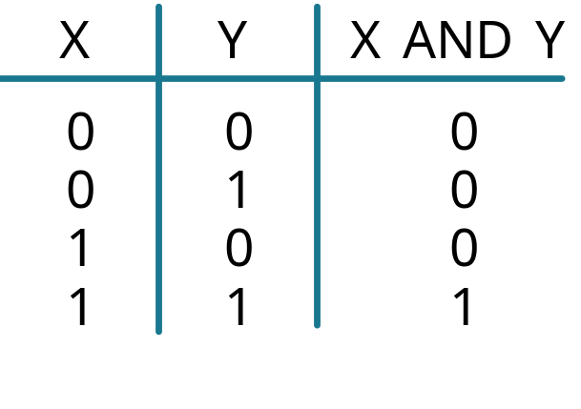
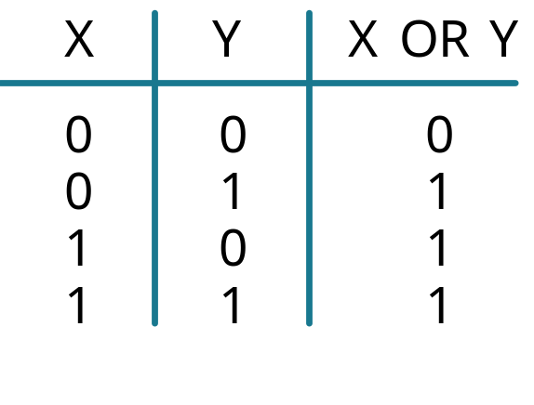
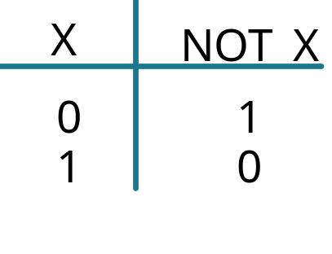
Digital Systems: Boolean Algebra and Logical Operations
In Boolean algebra:
  Values: 0,1
  0: if a logic statement is false,
  1: if a logic statement is true.
Operations: AND, OR, NOT

Slide 4
بررسی مثال قبلی
IF the garage door is open
AND the car is running
THEN the car can be backed out of the garage
door open?
car running?
back out car?
false/0
false/0
true/1
true/1
false/0
true/1
false/0
true/1
false/0
false/0
false/0
TRUE/1
2 گزینه برای هر متغیر
^{n}2 گزینه برایn متغیر
هر متغیر می‌تواند توسط یک سویچ پیاده‌سازی شود
چینش سویچ‌ها توسط نوع عملگرها تعیین می‌شود

Slide 5
سيستم‌هاي نوعي
Analog Phenomena
ورودي‌ها:
  فشار کليد (ديجيتال)
  درجة حرارت محيط (آنالوگ)
  تغييرات سطح مايع (آنالوگ)
خروجي‌ها:
  ولتاژ راه اندازي موتور (آنالوگ)
  بازکردن/بستن شير (آنالوگ يا ديجيتال)
  نمايش روي LCD (ديجيتال)
Sensors & other inputs
Analog Inputs
Digital Inputs
A2D
Digital Inputs
Digital System
Digital Outputs
Digital Outputs
D2A
Actuators and Other Outputs

Slide 6
مثال: دستگاه اطفاي حريق خودکار
Analog Phenomena
رفتار سيستم:
  اگر درجة حرارت محيط از مقدار مشخصي بيشتر است و کليد فعال سازي دستگاه روشن است، شير آب را باز کن.
Sensors & other inputs
Analog Inputs
Digital Inputs
A2D
Digital Inputs
Digital System
Digital Outputs
Digital Outputs
D2A
Actuators and Other Outputs

Slide 7

مثال: چراغ هشدار کمربند ايمني
Analog Phenomena
Sensors & other inputs
Analog Inputs
Digital Inputs
A2D
Digital Inputs
Digital System
  S = ‘1’: کمربند بسته است.
  K = ‘1’: سوييچ داخل است.
  P = ‘1’: راننده روي صندلي است.
Digital Outputs
Digital Outputs
D2A
Actuators and Other Outputs

Slide 8
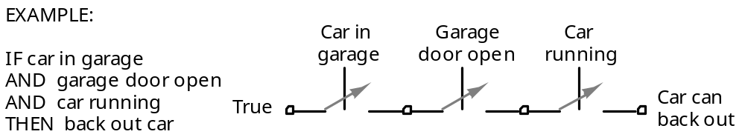
سويچ‌ها: عملگرهاي منطقي
EXAMPLE:
Garage door
Car in
open
garage
Car
IF
(car in driveway
running
OR
(car in garage
AND
garage door open))
True
Car can
AND
car running
back out
THEN
can back out car
True
Car in
driveway

Slide 9
Binary Logic
  Deals with binary variables that take 2 discrete values (0 and 1), and logic operations
  Basic logic operations:
    AND, OR, NOT
  Binary/logic variables are typically represented by letters: A,B,C,…,X,Y,Z

Slide 10
Binary Logic Function
F(vars) = expression
Example:
F(a,b) = a’•b + b’
G(x,y,z) = x•(y+z’)
Operators ( +, •, ‘ )
Variables
Constants ( 0, 1 )
Groupings (parenthesis)
set of binary
variables

Slide 11
Boolean Logic Operators
  AND (also •, )
  OR (also +, )
  NOT (also ’, )
  F(a,b) = a•b, reads F is 1 if and only if a=b=1
  G(a,b) = a+b, reads G is 1 if either a=1 or b=1 or both
  H(a) = a’, reads H is 1 if a=0
Binary
Unary

Slide 12
Boolean Operators (cont.)
1-bit logic AND resembles binary multiplication:
  0 • 0 = 0, 0 • 1 = 0,
  1 • 0 = 0, 1 • 1 = 1
1-bit logic OR resembles binary addition, except for one operation:
  0 + 0 = 0, 0 + 1 = 1,
  1 + 0 = 1, 1 + 1 = 1 (≠ 10₂)

Slide 13
Truth Tables for logic operators
Truth table:
A tabular form that uniquely represents the relationship between the input variables of a function and its output
2-Input AND
2-Input OR
NOT
A | B | F=A•B
0 | 0 | 0
0 | 1 | 0
1 | 0 | 0
1 | 1 | 1
A | B | F=A+B
0 | 0 | 0
0 | 1 | 1
1 | 0 | 1
1 | 1 | 1
A | F=A’
0 | 1
1 | 0

Slide 14
Truth Tables (cont.)
Q:
  Let a function F() depend on n variables. How many rows are there in the truth table of F() ?
A:
  2^{n} rows, since there are 2^{n} possible binary patterns/combinations for the n variables

Slide 15
Logic Gates
  Logic gates are abstractions of electronic circuit components that operate on one or more input signals to produce an output signal.
2-Input AND
2-Input OR
NOT (Inverter)
A
A
F
G
A
H
B
B
H = A’
F = A•B
G = A+B

Slide 16
Timing Diagram
t₀
t₁
t₂
t₃
t₄
t₅
t₆
A
1
Input
signals
0
1
Transitions
B
0
F=A•B
1
0
Basic
Assumption:
Zero time for
signals to
propagate
through gates
Gate
Output
Signals
G=A+B
1
0
H=A’
1
0

Slide 17
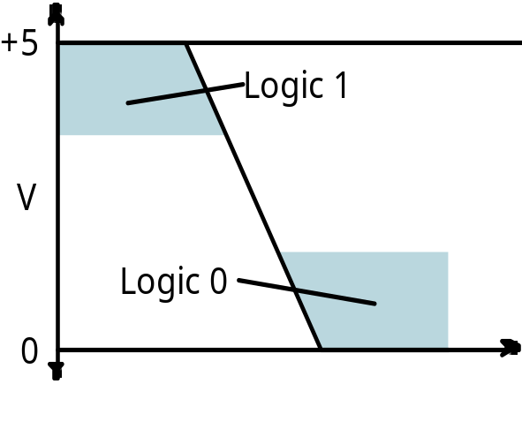
The Real World
  Physical electronic components are continuous, not discrete!
    Transition from logic 1 to logic 0 does not take place instantaneously in real digital systems
  These are the building blocks of all digital components
  Intermediate values may be visible for an instant
  Boolean algebra useful for describing the steady state behavior of digital systems
  Be aware of the dynamic, time varying behavior too!
Time

Slide 18
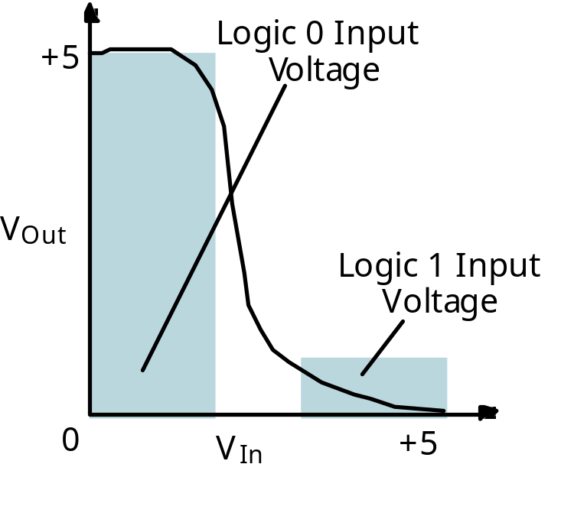
Inverter: a circuit that implements logical negation (NOT)
Inverter behavior as a function of input voltage:
Input changes from 0V to 5V
Output holds at 5V for some range of small input voltages
Then changes rapidly, but not instantaneously!

Slide 19
Combinational Logic Circuit from Logic Function
Combinational Circuit Design:
F = A’ + B•C’ + A’•B’
  Connect input signals and logic gates:
    Circuit input signals → from function variables (A, B, C)
    Circuit output signal → function output (F)
    Logic gates → from logic operations
C
A
F
B

Slide 20
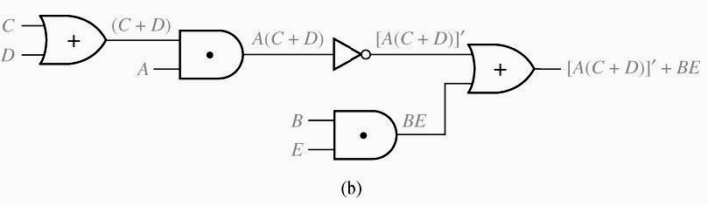
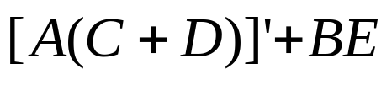
Logic Evaluation
Circuit of logic gates :
Logic Expression :
Logic Evaluation : If A=B=C=1, D=E=0, then:

Slide 21
Combinational Logic Optimization
  Consider functions F and G:
    F=A’ + B•C’ + A’•B’ and
    G=A’ + B•C’
  They seem different but let’s observe their truth tables
  They are identical → same function
  In order to design a cost-effective and efficient circuit, we must minimize
    the circuit’s size
      area
    propagation delay
      time required for an input signal change to be observed at the output line
  Use G to implement the logic circuit
    Fewer components
A | B | C | F | G
0 | 0 | 0 | 1 | 1
0 | 0 | 1 | 1 | 1
0 | 1 | 0 | 1 | 1
0 | 1 | 1 | 1 | 1
1 | 0 | 0 | 0 | 0
1 | 0 | 1 | 0 | 0
1 | 1 | 0 | 1 | 1
1 | 1 | 1 | 0 | 0

Slide 22
Combinational Logic Optimization
C
    F=A’ + B•C’ + A’•B’
A
F
B
C
    G=A’ + B•C’
B
A
G

Slide 23
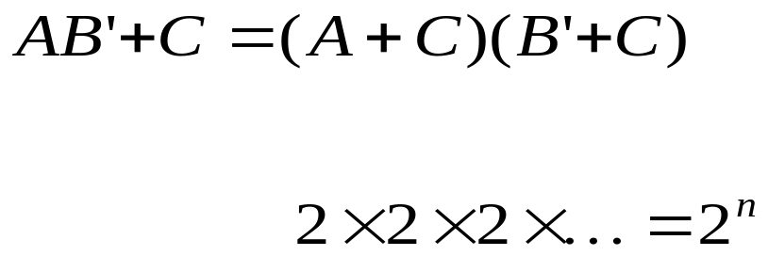
Equivalence Checking
Using Truth Table
?
n variable needs rows
n times
A B C |  | B’ | AB’ | AB’ + C |  | A + C | B’ + C | (A + C) (B’ + C)
0 0 0 0 0 1 0 1 0 0 1 1 1 0 0 1 0 1 1 1 0 1 1 1 |  | 1 1 0 0 1 1 0 0 | 0 0 0 0 1 1 0 0 | 0 1 0 1 1 1 0 1 |  | 0 1 0 1 1 1 1 1 | 1 1 0 1 1 1 0 1 | 0 1 0 1 1 1 0 1

Slide 24
Boolean Algebra
  VERY nice machinery used to manipulate (simplify) Boolean functions
  George Boole (1815-1864): “An investigation of the laws of thought”
  Terminology:
    Literal: A variable or its complement
      A, B’, x’
    Product term: literals connected by •
      X.Y
      A.B’.C.D,
    Sum term: literals connected by +
      A+B’
      A’+B’+C

Slide 25
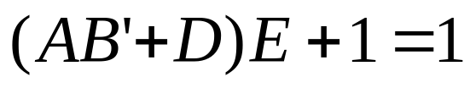
Boolean Algebra Properties
Let X: Boolean variable,
0,1: constants
  X + 0 = X -- Zero Axiom
  X • 1 = X -- Unit Axiom
  X + 1 = 1 -- Unit Property
  X • 0 = 0 -- Zero Property
A | B | F=A+B
0 | 0 | 0
0 | 1 | 1
1 | 0 | 1
1 | 1 | 1
A | B | F=A•B
0 | 0 | 0
0 | 1 | 0
1 | 0 | 0
1 | 1 | 1
Example:

Slide 26
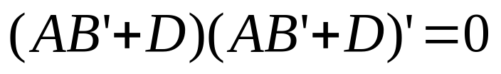
Boolean Algebra Properties (cont.)
A | B | F=A+B
0 | 0 | 0
0 | 1 | 1
1 | 0 | 1
1 | 1 | 1
Let X: Boolean variable,
0,1: constants
  X + X = X -- Idempotent
  X • X = X -- Idempotent
  X + X’ = 1 -- Complement
  X • X’ = 0 -- Complement
  (X’)’ = X -- Involution
A | B | F=A•B
0 | 0 | 0
0 | 1 | 0
1 | 0 | 0
1 | 1 | 1
Example:

Slide 27
The Duality Principle
  The dual of an expression is obtained by exchanging (• and +), and (1 and 0) in it,
    provided that the precedence of operations is not changed.
  Do not exchange x with x’
  Example:
    Find H(x,y,z), the dual of F(x,y,z) = x’yz’ + x’y’z
    H = (x’+y+z’).(x’+y’+z)
  Dual is not always equal to the original expression
If a Boolean equation/equality is valid, its dual is also valid

Slide 28
The Duality Principle (cont.)
  With respect to duality, identities 1 – 8 have the following relationships:
1. X + 0 = X 2. X • 1 = X (dual of 1)
3. X + 1 = 1 4. X • 0 = 0 (dual of 3)
5. X + X = X 6. X • X = X (dual of 5)
7. X + X’ = 1 8. X • X’ = 0 (dual of 7)

Slide 29
More Boolean Algebra Properties
Let X,Y, and Z: Boolean variables
10. X + Y = Y + X 11. X • Y = Y • X -- Commutative
12. X + (Y+Z) = (X+Y) + Z 13. X•(Y•Z) = (X•Y)•Z -- Associative
14. X•(Y+Z) = X•Y + X•Z 15. X+(Y•Z) = (X+Y) • (X+Z) -- Distributive
16. (X + Y)’ = X’ • Y’ 17. (X • Y)’ = X’ + Y’
-- DeMorgan’s Laws
In general:
( X₁ + X₂ + … + X_{n} )’ = X₁’•X₂’ • … •X_{n}’
( X₁•X₂•… •X_{n} )’ = X₁’ + X₂’ + … + X_{n}’

Slide 30

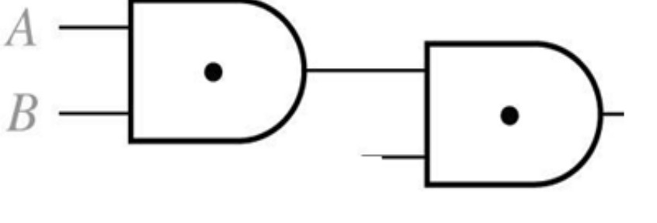
Associative Laws for AND
B
A
C
=
B
A
C
A(BC)=ABC

Slide 31
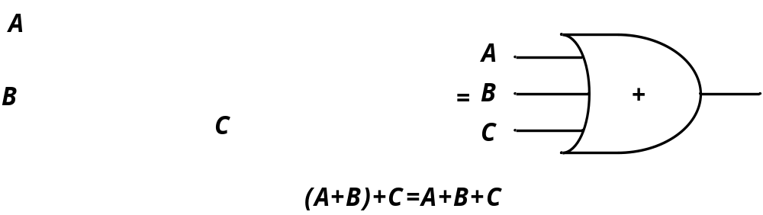
Associative Laws for OR

Slide 32
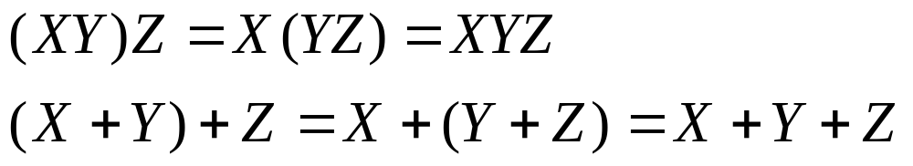
Proof of Associative Law
Associative Laws:
Proof of Associative Law for AND:
X Y Z |  | XY YZ | (XY)Z X(YZ)
0 0 0 0 0 1 0 1 0 0 1 1 1 0 0 1 0 1 1 1 0 1 1 1 |  | 0 0 0 0 0 0 0 1 0 0 0 0 1 0 1 1 | 0 0 0 0 0 0 0 0 0 0 0 0 0 0 1 1

Slide 33
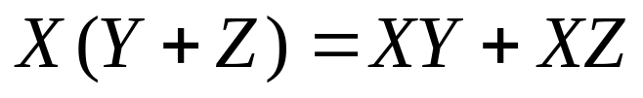

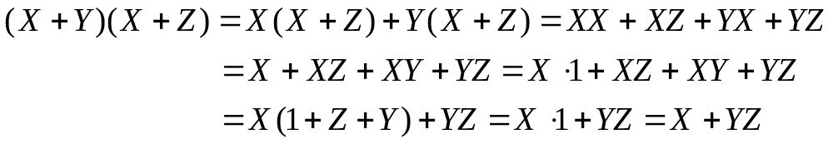
Distributive Law
Distributive Laws:
Valid only for Boolean algebra not for ordinary algebra
Proof of the second law:
Note that the first law is used to prove the second one. But considering duality, there was no need to prove the second one!

Slide 34
Absorption Property (Covering)
  x + x•y = x
  x•(x+y) = x (dual)
Proof:
x + x•y = x•1 + x•y
= x•(1+y)
= x•1
= x
QED (2 true by duality)
Notes:
The terminology “absorption property” comes from the Set Theory. Give the interpretation in there.
QED stands for quod erat demonstrandum (a Latin term meaning: this is what needed to be shown)

Slide 35
Absorption Property (Covering)
  x + x’•y = x + y
  x•(x’+y) = x y (dual)
Proof of 2:
x • (x’+ y) = x•x’ + x•y
= 0 + (x•y)
= x•y
QED (1 true by duality)
Notes:
Again: the interpretation of the properties using Set Theory

Slide 36
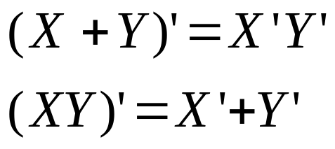
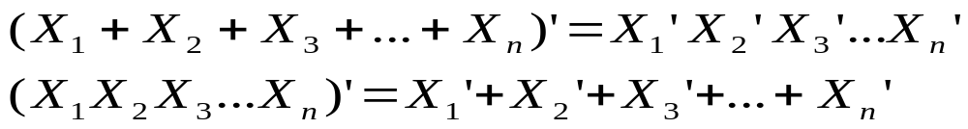
DeMorgan’s Laws
Proof
X Y |  | X’ Y’ | X + Y | ( X + Y )’ | X’ Y’ |  | XY | ( XY )’ | X’ + Y’
0 0 0 1 1 0 1 1 |  | 1 1 1 0 0 1 0 0 | 0 1 1 1 | 1 0 0 0 | 1 0 0 0 |  | 0 0 0 1 | 1 1 1 0 | 1 1 1 0
DeMorgan’s Laws for n variables
Example
Notes:
To prove for n=3, use the proof for n=2
For larger n, use the proof for n-1 (Mathematical Induction)

Slide 37
Consensus Theorem
  xy + x’z + yz = xy + x’z
  (x+y)•(x’+z)•(y+z) = (x+y)•(x’+z) (dual)
  Proof:
  xy + x’z + yz = xy + x’z + (x+x’)yz
  = xy + x’z + xyz + x’yz
  = (xy + xyz) + (x’z + x’zy)
  = xy + x’z
  QED (2 true by duality).

Slide 38
Consensus Theorem
Example:

Slide 39
Consensus Theorem
Example:

Slide 40

Consensus Theorem
Example:
Reducing an expression:
Add one term and eliminate two!
Consensus
term added
Final expression

Slide 41
Algebraic Manipulation
  Boolean algebra is a useful tool for simplifying digital circuits.
  Why do simplification?
    Fan-in (number of gate inputs) is limited in some technologies:
      Reduce the number of literals (gate inputs)
    Number of gates influences manufacturing costs
      Reduce the number of gates
    Fewer levels of gates implies reduced signal propagation delays and faster design
      Reduce number of levels of gates (logical depth)

Slide 42
Graphic Look at Algebraic Manipulation
All various forms of an arbitrary Boolean function with a unique truth table may be considered points in the big circle
Assume brown x is an arbitrary starting point
Assume green x is the optimal point
Amber manipulation path is a correct but long path from the starting point to the optimal
Green path is a better path to the optimal point
Correct manipulations remain within the circle
Any incorrect manipulation takes you out of the circle (the red arrow)
An Arbitrary Boolean Function

Slide 43








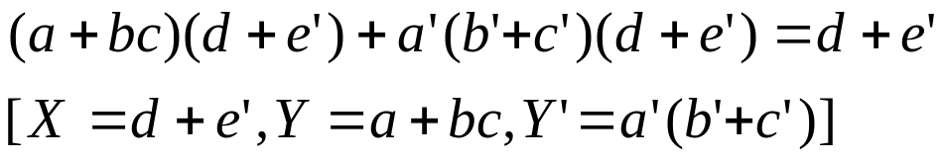

Algebraic Simplification
1. Combining terms
Example:
2. Adding terms using
Example:
3. Eliminating terms
Example:
Example:
Example:

Slide 44
Algebraic Manipulation Example
  Example: Simplify F = x’yz + x’yz’ + xz.
  F= x’yz + x’yz’ + xz
  = x’y(z+z’) + xz
  = x’y•1 + xz
  = x’y + xz
x
y
F
z
x
y
F
z

Slide 45
Algebraic Manipulation (cont.)
  Example: Prove
  x’y’z’ + x’yz’ + xyz’ = x’z’ + yz’
  Proof:
  x’y’z’+ x’yz’+ xyz’
  = x’y’z’ + x’yz’ + x’yz’ + xyz’
  = x’z’(y’+y) + yz’(x’+x)
  = x’z’•1 + yz’•1
  = x’z’ + yz’
  QED.

Slide 46




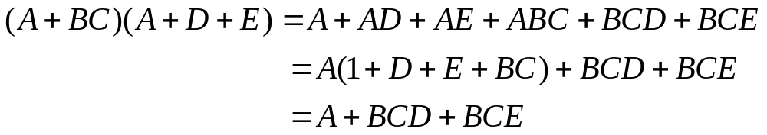
Sum of Products (SoP)
Sum of products form:
Still considered to be in sum of products form:
Not in sum of products form:
Multiplying out and eliminating redundant terms

Slide 47

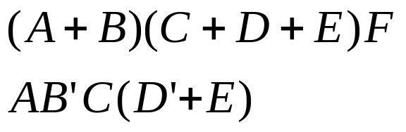
Product of Sums (PoS)
Product of sums form:
Still considered to be in product of sums form:

Slide 48
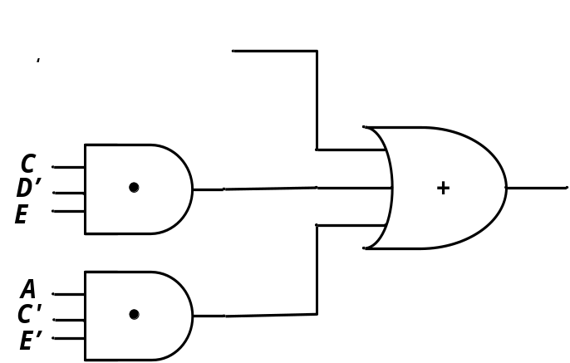

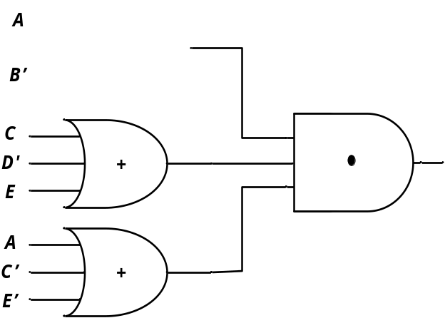

Circuits for SoP and PoS Forms
Sum of products form
Product of sums form

Slide 49
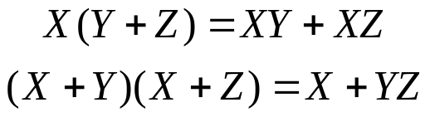
Multiplying Out and Factoring
To obtain a sum of products form ➔ Multiply out using distributive laws



A useful theorem for multiplying out:
(
X
+
Y
)(
X
'
+
Z
)
=
XZ
+
X
'
Y
(3-3)







If
X
=
0,
(3
-
3)
reduces
to
Y(1
+
Z)
=
0
+
1
∗
Y
or
Y
=
Y.
If
X
=
1,
(3
-
3)
reduces
to
(1
+
Y)Z
=
Z
+
0
∗
Y
or Z
=
Z.
Example:



The use of Theorem 3-3 for factoring:
A
B
+
A
'
C
=
(
A
+
C
)(
A
'
+
B
)






Slide 50
Multiplying out (another proof)
Theorem for multiplying out:
(
Q
+
AB
'
)(
C
'
D
+
Q
'
)
=
QC
'
D
+
Q
'
AB
'
Multiplying out
using distributive laws
Redundant terms
multiplying out: (a) distributive laws (b) theorem(3-3):
(
A
+
B
+
C
'
)(
A
+
B
+
D
)(
A
+
B
+
E
)(
A
+
D
'
+
E
)(
A
'
+
C
)
=
(
A
+
B
+
C
'
D
)(
A
+
B
+
E
)[
AC
+
A
'
(
D
'
+
E
)]
=
(
A
+
B
+
C
'
DE
)(
AC
+
A
'
D
'
+
A
'
E
)
=
AC
+
ABC
+
A
'
BD
'
+
A
'
BE
+
A
'
C
'
DE
What theorem was applied to eliminate ABC ?

Slide 51
Factoring Expressions
To obtain a product of sums form ➔ Factoring using distributive laws



Theorem for factoring:
A
B
+
A
'
C
=
(
A
+
C
)(
A
'
+
B
)





Example of factoring:
AC
+
A
'
BD
'
+
A
'
BE
+
A
'
C
'
DE
=
AC
+
A
'
(
BD
'
+
BE
+
C
'
DE
)
XZ
X
'
Y
=
(
A
+
BD
'
+
BE
+
C
'
DE
)(
A
'
+
C
)
=
[
A
+
C
'
DE
+
B
(
D
'
+
E
)](
A
'
+
C
)
X
Y
Z
=
(
A
+
B
+
C
'
DE
)(
A
+
C
'
DE
+
D
'
+
E
)(
A
'
+
C
)
=
(
A
+
B
+
C
'
)(
A
+
B
+
D
)(
A
+
B
+
E
)(
A
+
D
'
+
E
)(
A
'
+
C
)

Slide 52
Truth Tables (revisited)
  Enumerates all possible combinations of variable values and the corresponding function value
  Truth tables for some arbitrary functions
  F₁(x,y,z), F₂(x,y,z), and F₃(x,y,z) are shown to the right.
x | y | z |  | F₁ | F₂ | F₃
0 | 0 | 0 |  | 0 | 1 | 1
0 | 0 | 1 |  | 0 | 0 | 1
0 | 1 | 0 |  | 0 | 0 | 1
0 | 1 | 1 |  | 0 | 1 | 1
1 | 0 | 0 |  | 0 | 1 | 0
1 | 0 | 1 |  | 0 | 1 | 0
1 | 1 | 0 |  | 0 | 0 | 0
1 | 1 | 1 |  | 1 | 0 | 1

Slide 53
Truth Tables (cont.)
  Truth table: a unique representation of a Boolean function
  If two functions have identical truth tables, the functions are equivalent (and vice-versa).
  Truth tables can be used to prove equality theorems.
  However, the size of a truth table grows exponentially with the number of variables involved.
    This motivates the use of Boolean Algebra.

Slide 54
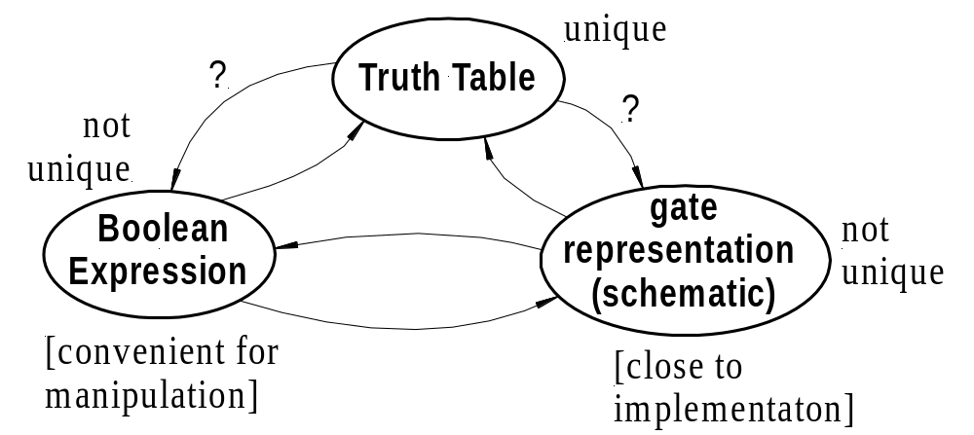
Relationship Among Representations
Theorem:
  Any Boolean function that can be expressed as a truth table can be written as an expression in Boolean Algebra using AND, OR, NOT.
covered
covered
covered
covered
How do we convert from one to the other?
Optimizations?

Slide 55
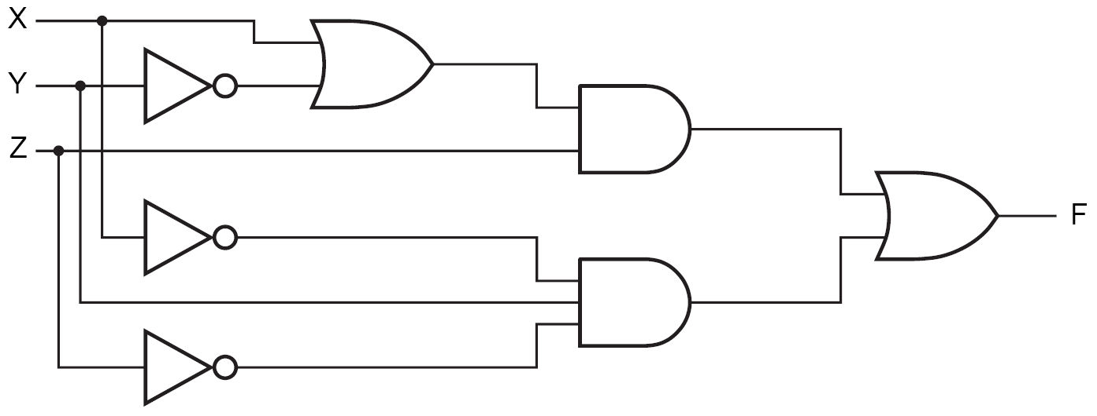
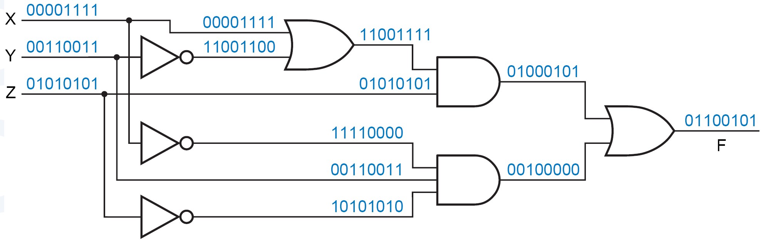
Circuit Analysis: Gate to TT
  Circuit to be analyzed:
  Consider all possible combinations of inputs

Slide 56
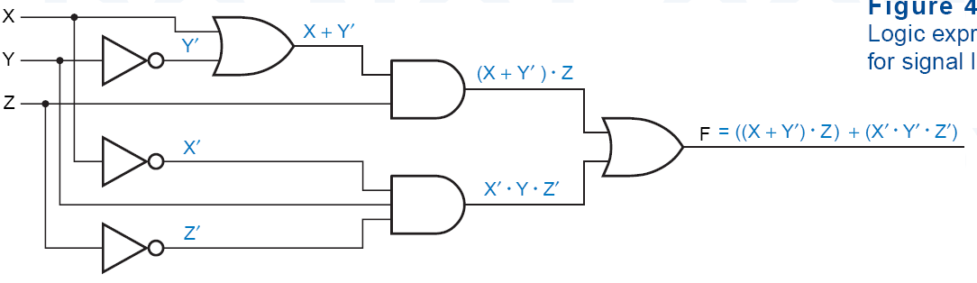
Circuit Analysis: Gate to Boolean
  Circuit to be analyzed:
  Can also name the nodes
N₁ = X+Y’
N₂ = N₁.Z
N₁
N₃ = X’.Y.Z’
N₂
F = N₂+N₃
N₃
F = N₁.Z+ X’.Y.Z’
= (X+Y’). Z+ X’.Y.Z’

Slide 57
Boolean expressions-
NOT unique
x | y | z |  | F | G
0 | 0 | 0 |  | 1 | 1
0 | 0 | 1 |  | 0 | 0
0 | 1 | 0 |  | 1 | 1
0 | 1 | 1 |  | 0 | 0
1 | 0 | 0 |  | 0 | 0
1 | 0 | 1 |  | 0 | 0
1 | 1 | 0 |  | 1 | 1
1 | 1 | 1 |  | 0 | 0
  Unlike truth tables, expressions representing a Boolean function are NOT unique.
  Example:
    F(x,y,z) = x’•y’•z’ + x’•y•z’ + x•y•z’
    G(x,y,z) = x’•y’•z’ + y•z’
  The corresponding truth tables for F() and G() are identical!
  Thus, F() = G()

Slide 58
Complementation: Example
Find the complement of
F(x,y,z) = xy’z’ + x’yz
  G = F’ = (xy’z’ + x’yz)’
  = (xy’z’)’ • (x’yz)’ DeMorgan
  = (x’+y+z) • (x+y’+z’) DeMorgan again
Note:
  The complement of a function can also be derived by finding the function’s dual, and then complementing all of the literals

Slide 59
Complement of a Function
• ↔ +
1 ↔ 0
X ↔ X’
  interchange 1s to 0s in the truth table column showing F.
  The complement of a function IS NOT THE SAME as the dual of a function.

Slide 60
De Morgan’s Law for a Complex Expression
To invert a function,
  Complement all variables and constants,
  Exchange all + ↔ .
Example:
  ((A + B’).C’.D + EF)’
  = ((A’.B) + C + D’) . (E’ + F’)
Note:
  Don’t change operator precedence

Slide 61





Boolean vs. Ordinary Algebra
Some of Boolean Algebra are not true for ordinary algebra
Example:
True in ordinary algebra
Not True in Boolean algebra
Example:
True in ordinary algebra
Not True in Boolean algebra
Some of Boolean Algebra properties are true for ordinary algebra too.
Example:
True in both ordinary and
Boolean algebra

Slide 62
Gate to Truth Table
  Circuit to be analyzed:
  Consider all possible combinations of inputs

Slide 63
Ckt to Boolean + Boolean to TT
Circuit of logic gates :
Logic Expression :
Logic Evaluation : A=B=C=1, D=E=0

Slide 64
Boolean to Ckt
Combinational Circuit Design:
F = A’ + B•C’ + A’•B’
  connect input signals and logic gates:
    Circuit input signals → from function variables (A, B, C)
    Circuit output signal → function output (F)
    Logic gates → from logic operations
C
A
F
B

Slide 65
Minterms and Maxterms
Minterm:
  A product term (with value 1) in which all the variables appear exactly once, either complemented or uncomplemented
Maxterm:
  A sum term (with value 0) in which...
  Minterms and Maxterms are easy to denote using a truth table.
  Note: m_{i} = M_{i}’
x | y | z |  | Minterm | Maxterm
0 | 0 | 0 |  | x’y’z’ = m₀ | x+y+z = M₀
0 | 0 | 1 |  | x’y’z = m₁ | x+y+z’ = M₁
0 | 1 | 0 |  | x’yz’ = m₂ | x+y’+z = M₂
0 | 1 | 1 |  | x’yz = m₃ | x+y’+z’= M₃
1 | 0 | 0 |  | xy’z’ = m₄ | x’+y+z = M₄
1 | 0 | 1 |  | xy’z = m₅ | x’+y+z’ = M₅
1 | 1 | 0 |  | xyz’ = m₆ | x’+y’+z = M₆
1 | 1 | 1 |  | xyz = m₇ | x’+y’+z’ = M₇

Slide 66
Canonical Forms: Unique
  Any Boolean function F( ) can be expressed as a unique sum of minterms (and a unique product of maxterms)
  In other words, every function F() has two canonical forms:
    Canonical Sum-Of-Products (sum of minterms)
    Canonical Product-Of-Sums (product of maxterms)

Slide 67
Graphic Look at SoP and PoS
An Arbitrary Boolean Function
Canonical SoP or
sum of minterms
Canonical PoS or product of maxterms
Sum of Products
Product of Sums

Slide 68
Canonical Forms (cont.)
Canonical Sum-Of-Products:
  The minterms included are those m_{j} such that F( ) = 1 in row j of the truth table for F( ).
Canonical Product-Of-Sums:
  The maxterms included are those M_{j} such that F( ) = 0 in row j of the truth table for F( ).

Slide 69
Example
a | b | c |  | f₁
0 | 0 | 0 | 0 | 0
0 | 0 | 1 | 1 | 1
0 | 1 | 0 | 2 | 1
0 | 1 | 1 | 3 | 0
1 | 0 | 0 | 4 | 1
1 | 0 | 1 | 5 | 0
1 | 1 | 0 | 6 | 1
1 | 1 | 1 | 7 | 0
  f₁(a,b,c) = m₁ + m₂ + m₄ + m₆
  = a’b’c + a’bc’ + ab’c’ + abc’
  f₁(a,b,c) = M₀ • M₃ • M₅ • M₇
  = (a+b+c)•(a+b’+c’)• (a’+b+c’)•(a’+b’+c’).
Again observe that m_{j} = M_{j}’

Slide 70
Shorthand: ∑ and ∏
f₁(a,b,c) = ∑ m(1,2,4,6),
  m₁+ m₂ + m₄ + m₆.
f₁(a,b,c) = ∏ M(0,3,5,7),
  M₀ . M₃ . M₅ . M₇.
  ∑ m(1,2,4,6) = ∏ M(0,3,5,7) = f₁(a,b,c)

Slide 71
Conversion Between Canonical Forms
  Replace ∑ with ∏ (or vice versa) and replace those j’s that appeared in the original form with those that did not.
Example:
  f₁(a,b,c) = a’b’c + a’bc’ + ab’c’ + abc’
  = m₁ + m₂ + m₄ + m₆
  = ∑(1,2,4,6)
  = ∏(0,3,5,7)
  = (a+b+c)•(a+b’+c’)•(a’+b+c’)•(a’+b’+c’)

Slide 72
Standard Forms (NOT Unique)
  Standard forms are “like” canonical forms,
    not all variables need to appear in the individual product (SOP) or sum (POS) terms.
Example:
  f₁(a,b,c) = a’b’c + bc’ + ac’
  is a standard sum-of-products form
  f₁(a,b,c) = (a+b+c)•(b’+c’)•(a’+c’)
  is a standard product-of-sums form.

Slide 73








Alternative Implementations
A
F(A,B,C) = Σm(3,4,5,6,7)
F = A' B C + A B' C' + A B' C + A B C' + A B C
B
Canonical Sum of Products
C
F
Standard Sum of Products
A + B C
F
Canonical Product of Sums
F
F(A,B,C) = ΠM(0,1,2)
= (A + B + C) (A + B + C') (A + B' + C)

Slide 74
Conversion of SOP from standard to canonical
  Expand non-canonical terms by inserting equivalent of 1 for each missing variable
    x: (x + x’) = 1
  Remove duplicate minterms
  f₁(a,b,c) = a’b’c + bc’ + ac’
  = a’b’c + (a+a’)bc’ + a(b+b’)c’
  = a’b’c + abc’ + a’bc’ + abc’ + ab’c’
  = a’b’c + abc’ + a’bc + ab’c’

Slide 75
Conversion of POS from standard to canonical
  Expand noncanonical terms by adding 0 in terms of missing variables (e.g., xx’ = 0) and using the distributive law
  Remove duplicate maxterms
  f₁(a,b,c) = (a+b+c)•(b’+c’)•(a’+c’)
  = (a+b+c)•(aa’+b’+c’)•(a’+bb’+c’)
  = (a+b+c)•(a+b’+c’)•(a’+b’+c’)•
  (a’+b+c’)•(a’+b’+c’)
  = (a+b+c)•(a+b’+c’)•(a’+b’+c’)•(a’+b+c’)

Slide 76
Conversion of Natural Language Sentences to Boolean Equations
  The first step in designing a logic network:
    To translate natural language sentences to Boolean equations:
      We must break down each sentence into phrases
      And associate a Boolean variable with each phrase (possible if a phrase can have a “true”/”false” value)
  Example:
    Ali watches TV if it is Monday night and he has finished his homework.
    → F = A . B

Slide 77
Main Steps
  Three main steps in designing a single-output combinational switching network:
    Find a switching function which specifies the desired behavior of the network.
    Find a simplified algebraic expression for the function.
    Realize the simplified function using available logic elements.

Slide 78
Example
  Four chairs in a row: design a circuit that shows a 1 if no adjacent chairs are empty
    Occupied: ‘1’
    Empty: ‘0’
    F = ‘1’ iff there are no adjacent empty chairs.
A
B
C
D
  F = (A’B’ + B’C’ + C’D’)’

Slide 79
Example (Continued)
  F = (A’B’ + B’C’ + C’D’)’
  = (A’B’)’ . (B’C’)’ . (C’D’)’
  = (A+B).(B+C).(C+D)
  = (B+AC).(C+D)
  = BC + BD + AC + ACD
  = BC + BD + AC

Slide 80
Problem Solving
  More often, we describe a logic function using a natural language connectives “and,” “or,” and “not.”
Example 2: An alarm circuit
  The house is secure if the WINDOW, DOOR, and GARAGE inputs are all 1
  The ALARM output is 1 if the PANIC input is 1, or if the ENABLE input is 1, the EXITING input is 0, and the house is not secure
SECURE = WINDOW . DOOR . GARAGE
ALARM = PANIC + ENABLE . EXITING′ . SECURE′
ALARM = PANIC + ENABLE . EXITING′ . (WINDOW . DOOR . GARAGE)′

Slide 81
Problem Solving
  Sometimes we have to work with imprecise word descriptions of logic functions.
Example 3:
  “The ERROR output should be 1 if the GEAR, CLUTCH, and BRAKE inputs are inconsistent.”
    e.g., the gear cannot be shifted unless the clutch is applied.
  In this situation:
    Truth-table approach is the best.
    It allows us to determine the output required for every input combination, based on our understanding of the problem and the knowledge of environment.

Slide 82
Example
A 4-bit Prime Number Detector
F = Σ_{N3,N2,N1,N0}(1, 2, 3, 5, 7, 11, 13)
=N3′.N2′.N1′.N0 + N3′.N2′.N1.N0′ + N3′.N2′.N1.N0+ N3′.N2.N1′.N0 + N3′.N2.N1.N0 + N3.N2′.N1.N0 + N3.N2.N1′.N0
N3′.N1′.N0 + N3′.N2′.N1 + N3′.N2.N1.N0 + N3.N2′.N1.N0 + N3.N2.N1′.N0
…
براي عبارات پيچيده، کار بهينه‌سازي سخت‌تر مي‌شود
نياز به روشي سيستماتيک و آسان‌تر: جدول کارنو
  شما را از جبر بول بي‌نياز نمي‌کند.

Slide 83
More Logic Gates
NAND:
  NOT-AND
    Its output = 1 if at least one input is 0.
    (A • B)’
  has traditionally been the universal gate in digital circuits.
    It is simple to implement in hardware and can be used to construct all other gates.
A | B | (A.B)’
0 | 0 | 1
0 | 1 | 1
1 | 0 | 1
1 | 1 | 0

Slide 84
More Logic Gates
NOR:
  NOT-OR
    Its output = 1 if all inputs are 0.
    (A + B)’
  Can be a universal gate.
A | B | (A+B)’
0 | 0 | 1
0 | 1 | 0
1 | 0 | 0
1 | 1 | 0

Slide 85
More Logic Gates
XOR:
  Inequality
    Its output = 1 if inputs are not equal.
    A O B
+
A | B | A XOR B
0 | 0 | 0
0 | 1 | 1
1 | 0 | 1
1 | 1 | 0

Slide 86
More Logic Gates
3-input XOR:
    Its output = 1 only if one input is 1 or all three inputs are 1.
    (A O B O C) = (A O B) O C = A O (B O C)
+
+
+
+
+
+
A | B | C | A XOR B XOR C
0 | 0 | 0 | 0
0 | 0 | 1 | 1
0 | 1 | 0 | 1
0 | 1 | 1 | 0
1 | 0 | 0 | 1
1 | 0 | 1 | 0
1 | 1 | 0 | 0
1 | 1 | 1 | 1

Slide 87
More Logic Gates
XNOR:
  Equality
    Its output = 1 if both inputs are equal.
    (A O B)’
+
A | B | A XNOR B
0 | 0 | 1
0 | 1 | 0
1 | 0 | 0
1 | 1 | 1

Slide 88





Theorems for XOR

Slide 89
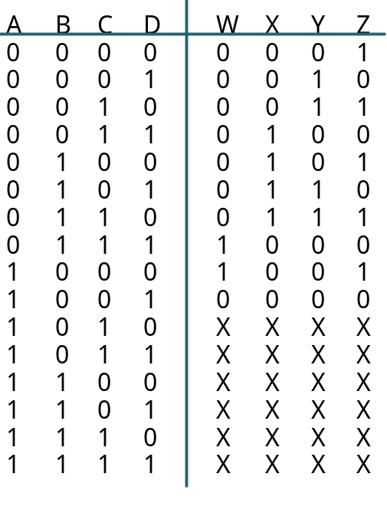
Incompletely Specified Functions
Don’t Care:
  We don’t care about the output values for some input patterns.
  This fact can be exploited during circuit minimization.
Example:
  BCD incrementer:
Off set of W
On set of W
Don't Care (DC) set of W
These input patterns should
never be encountered so in practice
associated output values are
"Don't Cares"

Slide 90
Don't Cares and Canonical Forms
Canonical Representations of the BCD Incrementer:
Z = m0 + m2 + m4 + m6 + m8 + d10 + d11 + d12 + d13 + d14 + d15
Z = Σm(0, 2, 4, 6, 8) + d(10, 11, 12 ,13, 14, 15)
Z = M1 • M3 • M5 • M7 • M9 • D10 • D11 • D12 • D13 • D14 • D15
Z= ΠM(1, 3, 5, 7, 9) • D(10, 11, 12, 13, 14 ,15)

